Slide 1


Exam DP-900: Microsoft Azure Data Fundamentals Crash Course
Tim Warner

Slide 2


Tim Warner
Based in Nashville, TN, US
Central time zone
MCT, MVP
Twitter: @TechTrainerTim
Badge: TechTrainerTim.com

Slide 3
Session 1 of 2 Agenda
Introduction
Core Data Concepts
Non-Relational Data
Relational Data (start)

Slide 4
Session 2 of 2 Agenda
Content catch-up
Relational Data (finish)
Data Analytics
Exam DP-900 strategy

Slide 5
Course Materials
timw.info/dp900

Slide 6
A Different Kind of Training
We'll learn by doing – at least 80 percent demo
Visual, case study approach
This is an expert certification, so we will move quickly and assume intermediate-level Azure skills
5-minute break at midpoint
I’m here to answer your questions – take advantage of this!
Use the Q&A panel

Slide 7

Session Recordings

Slide 8

Session Recordings

Slide 9

Session Recordings

Slide 10
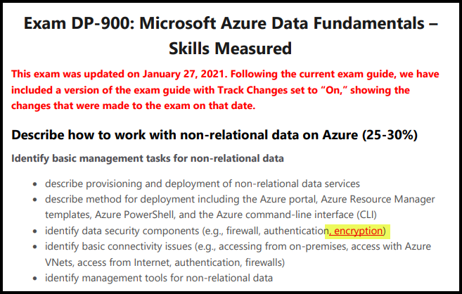
DP-900 Changes: January 27, 2021

Slide 11
Tim's Certification Study Pyramid
Interdependence
Content knowledge
Practical application
Test-taking skills

Slide 12
Thank you!
Course materials: timw.info/dp900
Twitter: @TechTrainerTim
Work: timw.info/ps
Web: TechTrainerTim.com

Slide 13
Core Data Concepts

Slide 14
Non-Relational Data

Slide 15
Relational Data

Slide 16
Data Analytics

Slide 17
Exam DP-900 Item Types

Slide 18

Multiple Choice

Slide 19
Repeated Scenario
You need to move an Azure VM to another hardware host.
Solution: You redeploy the VM.
Does this solution meet the goal?
Yes
No

Slide 20

Select and Place

Slide 21

Build List and Reorder

Slide 22

Active Screen/Fill in the Blank

Slide 23

Case Study

Slide 24






Performance-Based Lab

Slide 25
Microsoft Online Testing

Slide 26
Microsoft Online Testing Process
timw.info/online

Slide 27

Microsoft Online Testing Process

Slide 28

Microsoft Online Testing Process

Slide 29

Microsoft Online Testing Process

Slide 30

Microsoft Online Testing Process

Slide 31

Microsoft Online Testing Process

Slide 32

Microsoft Online Testing Process

Slide 33

Microsoft Online Testing Process

